Slide 1

Computer System Architecture
Course Code: CSE360
Lecture - 2
Computer Evolution and Performance

Slide 2
ENIAC – background: The First Generation
Electronic Numerical Integrator And Computer
Developed by Eckert and Mauchly
At University of Pennsylvania
Responsible for developing Trajectory tables for new weapons (without these firing tables, the new weapons and artillery were useless to gunners)
Started 1943
Finished 1946
  Too late for war effort
Used until 1955

Slide 3
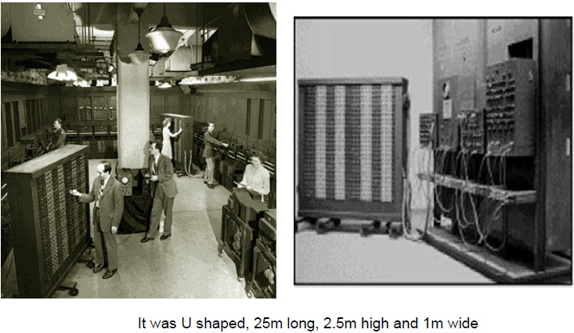
ENIAC - 1946

Slide 4
ENIAC - details
The resulting machine was enormous!!!
Weighting 30 tons
Occupying 15,000 square feet of floor space (30x50 feet)
Contains 18,000 vacuum tubes
140 kW power consumption when operating
Capable of 5,000 additions per second
Decimal number system (not binary); numbers were represented in decimal form and arithmetic was performed in the decimal system.
Memory consists of 20 accumulators, each capable of holding10 digits.
Major drawback
Programming was done manually by plugging and unplugging cables and setting switches. Data was entered by punched cards.
Programming for typical calculations took from half a hour to a day.

Slide 5
von Neumann/Turing
Von Neumann (mathematician) was a consultant to both ENIAC and EDVAC (Electronic discrete variable computer) projects
Proposal of Neumann, EDVAC
This idea known as stored program concept
In 1946, Von Neumann began to design a new stored program computer, referred to as IAS (Institute for Advanced Studies) computer, at the Princeton Institute for Advanced Studies
IAS computer, although not completed until 1952, is prototype of all subsequent general-purpose computers.
General structure of the IAS computer:
A main memory which stores both data and instructions
An arithmetic-logic unit (ALU) capable of operating on binary data
A control unit interpreting instructions in memory and causes them executing
Input and output equipment operated by control unit

Slide 6

Structure of von Neumann machine

Slide 7
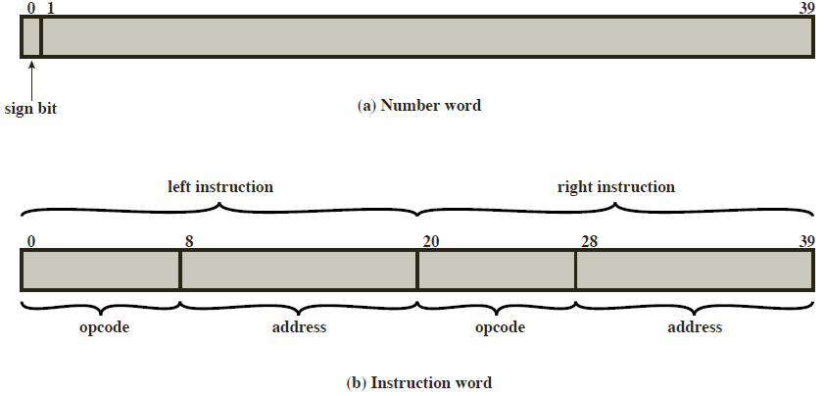
IAS - details
The memory of the IAS consists of 1000 storage locations, called words, of 40 binary digits (bits) each (1000 x 40 bit words).
Both data and instructions are stored here.
Each number is represented by a sign bit and a 39-bit value.
  A word may contain two 20-bit instructions (2 x 20 bit instructions) with each instruction consisting of an 8-bit operation code (opcode) specifying the operation to be performed and a 12-bit address designating one of the words in memory (numbered from 0 to 999).

Slide 8
IAS - details
A more detailed structure diagram as follows:
Both the control unit and the ALU contain storage locations, called registers
  Memory Buffer Register (MBR): Contains a word to be stored in memory or sent to the I/O unit, or is used to receive a word from memory or from the I/O unit.
  Memory Address Register (MAR): Specifies the address in memory of the word to be written into or read from the MBR.
  Instruction Register (IR): Contains the 8-bit opcode instruction being executed.
  Instruction Buffer Register (IBR): Employed to hold temporarily the right-hand instruction from a word in memory.
  Program Counter (PC): Contains the address of the next instruction-pair to be fetched from memory.
  Accumulator (AC) and Multiplier Quotient (MQ): Employed to hold temporarily operands and results of ALU operations, e.g. the result of multiplying two 40-bit numbers is an 80-bit number; the most significant 40 bits are stored in the AC and the least significant bit in the MQ.

Slide 9
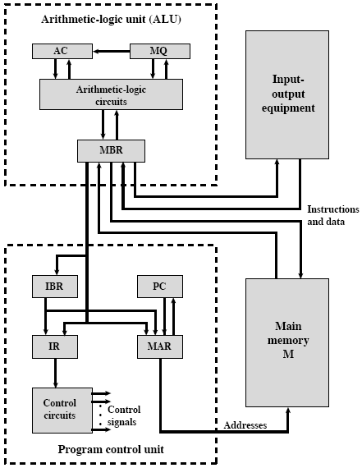
Structure of IAS – detail

Slide 10
Commercial Computers
In 1947 - Eckert-Mauchly Computer Corporation formed commercially.
First successful commercial computer was UNIVAC I (Universal Automatic Computer), which was commissioned by the US Bureau of Census for the 1950 calculations
The Eckert-Mauchly Computer Corporation became part of Sperry-Rand Corporation
Late 1950s - UNIVAC II had greater memory capacity and higher performance than the UNIVAC I.

Slide 11
IBM
IBM, which was then the major manufacturer of Punched-card processing equipment, delivered its first electronic stored-program computer, the 701, in 1953.
The 701 was intended primarily for scientific applications.
In 1955, the IBM introduced 702 product, which had a number of hardware features that suited for business applications
These were the first of a long series of 700/7000 computers.

Slide 12
The Second Generations: Transistors
Replacement of vacuum tube by the transistor
The transistor is smaller, cheaper, and dissipates less heat
Transistor is a semiconductor device used to amplify or switch electronic signals.
A transistor is made of a solid piece of a semiconductor material, with at least three terminals for connection to an external circuit. A voltage or current applied to one pair of the transistor's terminals changes the current flowing through another pair of terminals.
The transistor was invented at Bell Labs in 1947 and by the 1950s had launched an electronic revolution.
Fully transistorized computes were commercially available and IBM was again not the first company to deliver the new technology.
IBM followed shortly with the 7000 series.

Slide 13
Transistor Based Computers
The use of transistor defines the second generation of computers.
Each new generation is characterized by greater processing performance, larger memory capacity, and smaller size than the previous one. (See Table->next slide)
The second generation is important for the appearance of Digital Equipment Corporation (DEC) in 1957.
DEC delivered its first computer, the PDP-1
Programmed Data Processor (abbreviated PDP) was the name of a series of minicomputers made by Digital Equipment Corporation.

Slide 14
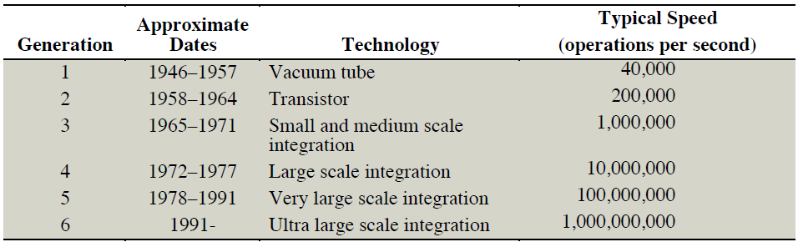
Generations of Computer

Slide 15
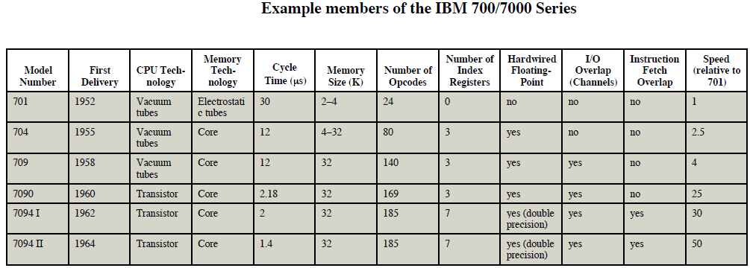
IBM 7094
From the introduction of the 700 series in 1952 to the introduction of the last member of the 700 series in 1964.
Product line shows increased performance, increased capacity, and low cost.
The size of the main memory grew from 2K to 32K words.
The time to access one word of memory, the memory cycle time, fell from 30µs to 1.4µs.
The number of opcodes grew from 24 to 185.
Speed improvements are achieved by improved electronics (e.g., a transistor implementation is faster than a vacuum tube) and more complex circuitry.

Slide 16
Third Generation: Integrated Circuits
A single, self-contained transistor is called a discrete component where transistors are packaged individually
Throughout the 1950s and early 1960s, electronic equipment was composed largely of discrete components – transistors, resistors, capacitors, and so on
Early second-generation computers contained about 10,000 transistors
This figure grew to the hundreds of thousands, making the new manufacture, more powerful machines.
In 1958, started the era of microelectronics and the invention of the integrated circuit (transistors are found in integrated circuits).
It is the integrated circuits that defines the third generation of computers.
Integrated circuit also known as IC, microcircuit, microchip, silicon chip, or chip

Slide 17
Microelectronics
Microelectronics means Literally - “small electronics”
A computer is made up of gates, memory cells, and interconnections
These can be manufactured on a semiconductor e.g. silicon wafer
Trend towards the reduction in size in digital electronic circuits.

Slide 18
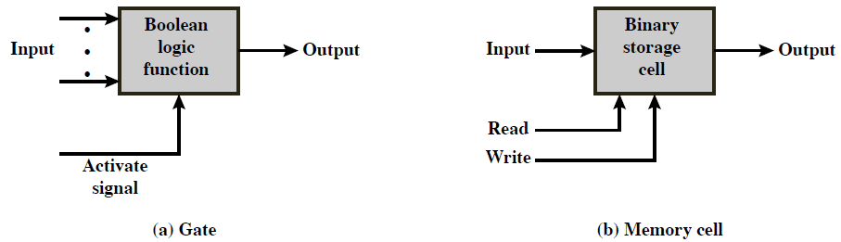
Microelectronics: Computer Elements
Only two fundamental types of components are required: gates and memory cell
A gate is a device that implements a simple Boolean or logical function, such as IF A AND B ARE TRUE THEN C IS TRUE (AND GATE)
Such devices are called gates because they control data flow in the same way that canal gates do.
The memory cell is a device that can store one bit of data

Slide 19
Microelectronics: Computer Elements
Four basic functions of a computer:
Data Storage: Provided by memory cells
Data processing: Provided by gates
Data movement: The paths between components are used to move data from memory to memory and from gates to memory
Control: A gate will have one or more data inputs plus a control signal input that activates the gate.
- When the control signal is ON, the gate performs its functions on the data inputs and produces a data output. Similarly, the memory cell will store the bit that is on its input lead when the WRITE control signal is ON and will place the bit that is in the cell on its output lead when the READ control signal is ON.

Slide 20
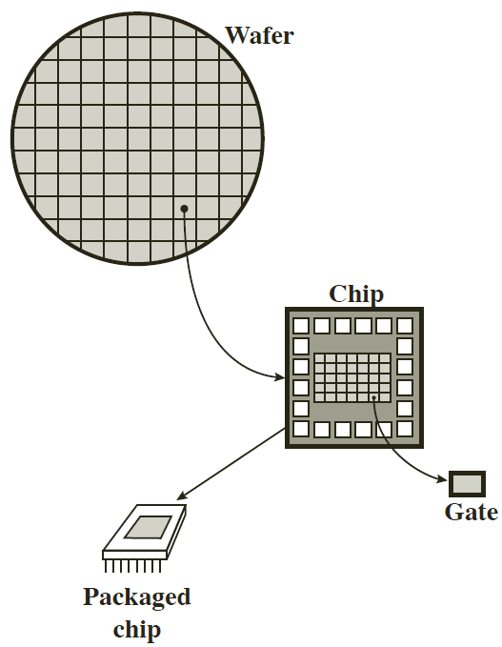
Integrated Circuit: Wafer, Chip, and Gate
A thin wafer of silicon is divided into a matrix of small areas, each a few millimeters square.
The identical circuit pattern is fabricated in each area, and the wafer is broken up into chips.
Each chip consists of many gates and/or memory cells plus a number of input and output attachment points.
The chip is then packaged that protects it and provides pins for attachment to devices beyond the chip.
A number of these packages can then be interconnected on a printed circuit board to produce larger and more complex circuits.

Slide 21
Moore’s Law
Initially, only a few gates or memory cells could be reliably manufactured and packaged together; these early integrated circuits are referred to as small-scale integration (SSI).
It became possible to pack more and more components on the same chip.
Increased density of components on chip
Moore’s law by Gordon Moore – co-founder of Intel
Number of transistors on a chip will double every year
Since 1970’s development has slowed a little
  Number of transistors doubles every 18 months
Cost of a chip has remained almost unchanged
Higher packing density means shorter electrical paths, giving higher performance
The computer becomes smaller, making it more convenient to place in a variety of environments.
Reduced power and cooling requirements
The interconnections on the integrated circuit are much more reliable. With more circuitry on each chip, there are fewer interchip connections.

Slide 22
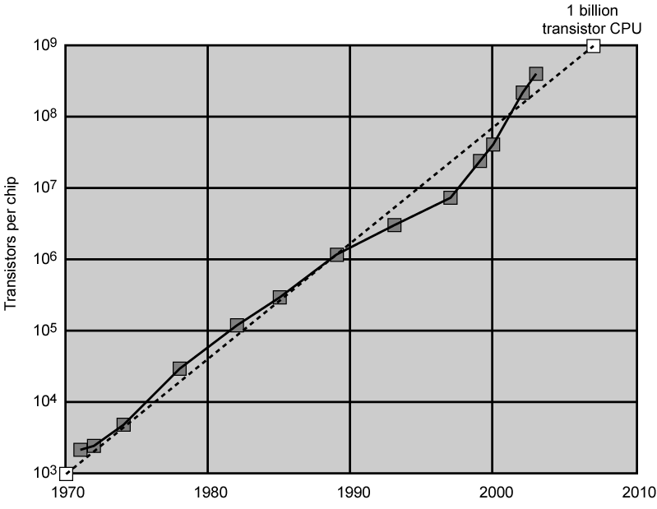
Growth in CPU Transistor Count

Slide 23
IBM System/ 360 series
1964
Replaced (& not compatible with) 7000 series
First planned “family” of computers
  Similar or identical instruction sets
  Similar or identical O/S
  Increasing speed
  Increasing number of I/O ports (i.e. more terminals)
  Increased memory size
  Increased cost
Multiplexed switch structure

Slide 24
DEC PDP-8
PDP-8 from Digital Equipment Corporation (DEC) in 1964
First minicomputer
Did not need air conditioned room
Small enough to sit on a lab bench
$16,000
  $100k+ for IBM 360
Embedded applications & OEM (Original Equipment Manufacturers)
BUS STRUCTURE

Slide 25
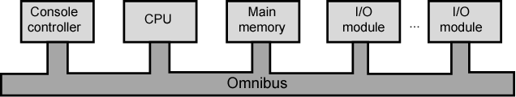
DEC - PDP-8 Bus Structure
PDP-8 bus, called the Omnibus, consists of 96 separate signal paths, used to carry control, address, and data signals.
All system components share a common set of signal paths, their use must be controlled by the CPU.
This architecture is highly flexible, allowing modules to be plugged into the bus to create various configurations.

Slide 26
Later Generations
For large scale integration (LSI), more than 1000 components can be placed on a single integrated circuit chip.
For very large scale integration (VLSI), more than 10,000 components per chip.
For ultra large scale integration (ULSI), more than one million components.

Slide 27
Semiconductor Memory
In 1970, Fairchild produced the fist semiconductor memory.
This chip, about the size of a single core, could hold 256 bits of memory.
It was non destructive and faster than core
It took only 70 billionths of a second to read a bit.
However, cost per bit was higher than for that of core.
Since 1970, semiconductor memory has been through 11 generations: 1K, 4K, 16K, 64K, 256K, 1M, 4M, 16M, 64M, 256M, and 1G. Each generation has provided four times the storage density of the previous generations, accompanied by declining cost per bit and declining access time.

Slide 28
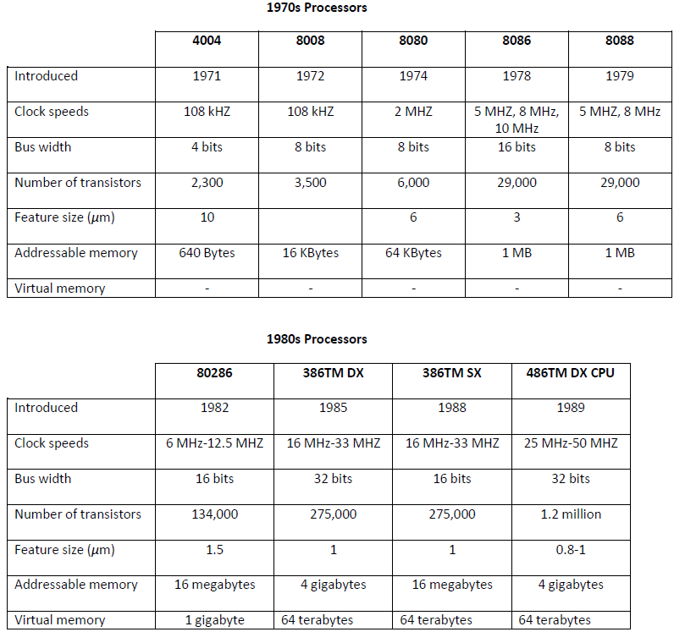
Evaluation of Intel Microprocessors

Slide 29
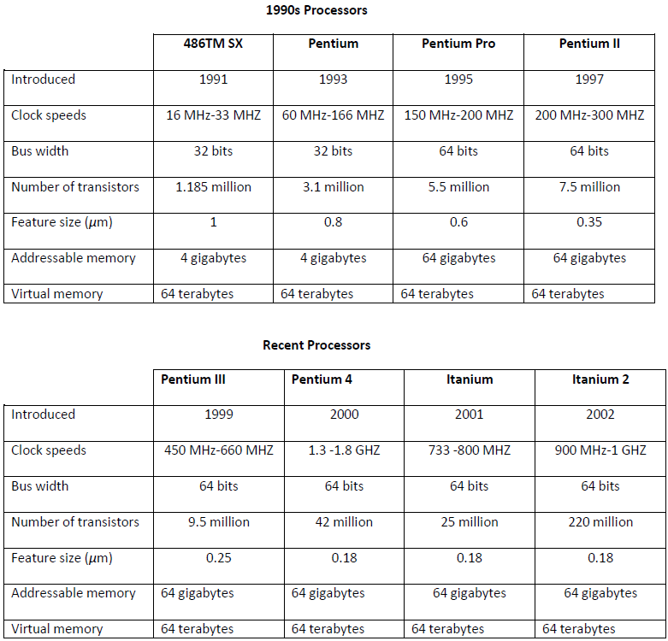
Evaluation of Intel Microprocessors

Slide 30
Speeding it up
Pipelining: A processor organization in which the processor consists of a number of stages, allowing multiple instructions to be executed concurrently.
On board cache: A special buffer storage, smaller and faster than main storage, that is used to contain a copy of instructions and data from main memory that are to be needed next by the processor (to reduce the average time to access the memory).
On board L1 & L2 cache
Branch prediction: A mechanism used by the processor to predict which branches or groups of instructions are likely to be processed next.
Data flow analysis: The processor analyzes which instructions are dependent on each other’s results, or data, to create an optimized schedule of instructions. Instructions are scheduled to be executed when ready, independent of the original program order. This prevents unnecessary delay.
Speculative execution: Using branch prediction and data flow analysis, some processors speculatively execute instructions ahead of their actual appearance in the program execution, holding the results in temporary locations to keep its execution engines as busy as possible by executing instructions that likely to be needed.

Slide 31
Performance Balance
Processor speed increased
Memory capacity increased
Memory speed lags behind processor speed

Slide 32
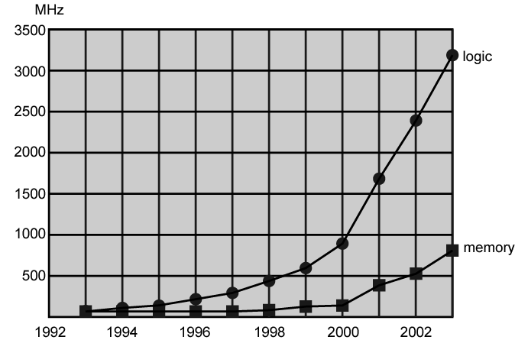
Logic and Memory Performance Gap

Slide 33
Solutions
Increase number of bits retrieved at one time
  Make DRAM (direct memory access controls the exchange of data between main memory and I/O module) “wider” rather than “deeper”
Change DRAM interface
  Include “Cache” on the DRAM chip
Reduce frequency of memory access by
  More complex cache and cache on chip
Increase interconnection bandwidth between processors and memory by
  High speed buses

Slide 34
Handling of I/O Devices
Computers become faster and more capable, more sophisticated applications are developed that support the use of peripherals with intensive I/O demands
I/O devices create large data throughput demands
Processors can handle the data pumped out by these I/O devices
Problem is getting data moved between processor and peripheral.
Solutions to satisfy I/O demands:
  Caching
  Buffering
  Higher-speed interconnection buses
  More elaborate bus structures
  Multiple-processor configurations

Slide 35
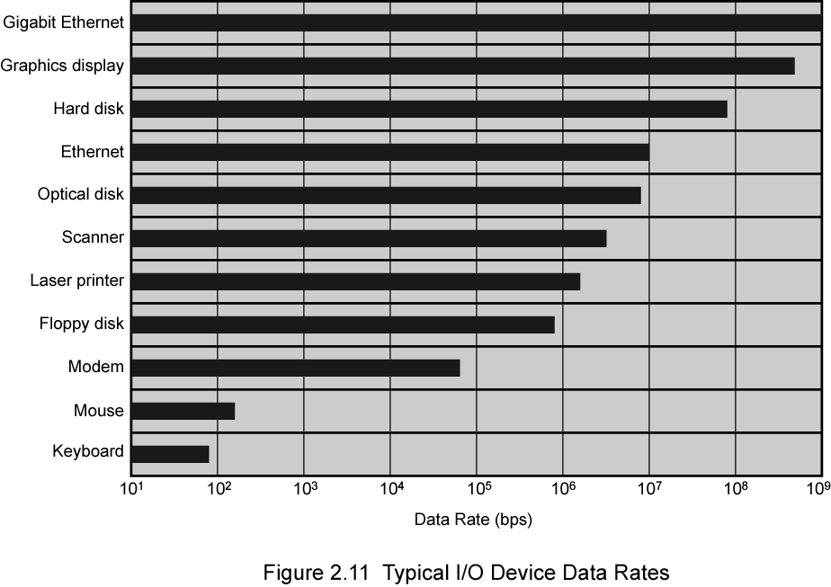
Typical I/O Device Data Rates

Slide 36
Key is Balance
Designers constantly strive to balance the throughput and processing demands of:
Processor components
Main memory
I/O devices
Interconnection structures
The idea is to cope with the following two factors:
The rate at which performance is changing in various technology areas (processors, buses, memory, peripherals) in terms of typical instruction profile and the data access patterns.
New applications and new peripheral devices constantly change the nature of the demand

Slide 37
Improvements in Chip Organization and Architecture
Increase speed of processor
  Fundamentally due to shrinking logic gate size
    More gates, packed more tightly, increasing clock rate
    With gates closer together, propagation time for signals reduced, that speeds up the processor (increase in clock rate means individual operations are executed more rapidly)
Increase size and speed of caches between processors and main memory
    Cache access times drop significantly
Change to processor organization and architecture
  Increase effective speed of execution
  Parallelism

Slide 38
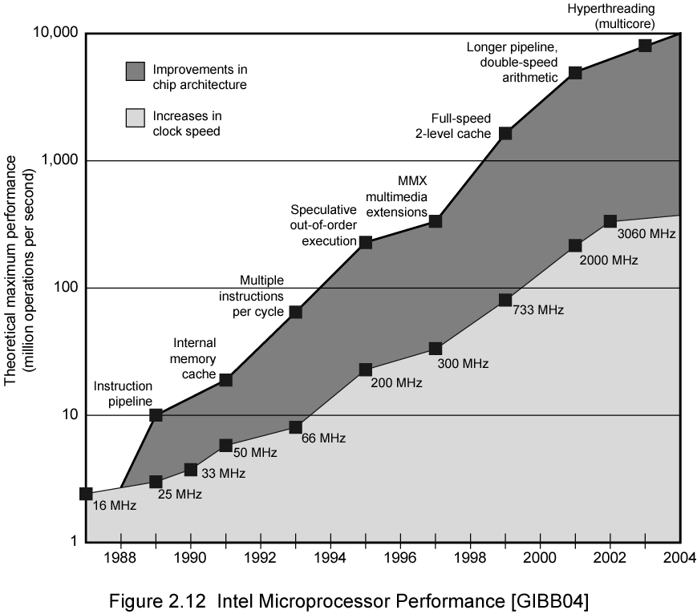
Intel Microprocessor Performance

Slide 39
Strategies to increase performance – Since 1980
Firstly, Increased Cache Capacity
Typically two or three levels of cache between processor and main memory
Chip density increased
  More cache memory on chip
    Faster cache access
Pentium chip devoted about 10% of on-chip area to a cache
Pentium 4 devotes about 50%

Slide 40
Strategies to increase performance – Since 1980
Secondly, More Complex Execution Logic
Enable parallel execution of instructions
Pipeline works like assembly line
  Different stages of execution of different instructions at same time along pipeline
Superscalar allows multiple pipelines within single processor
  Instructions that do not depend on one another can be executed in parallel

Slide 41
Diminishing Returns
Internal organization of contemporary processors is exceedingly complex
  Can get a great deal of parallelism
  Further significant increases likely to be relatively modest
Benefits from cache are reaching limit
Increasing clock rate runs into power dissipation problem (the faster the clock rate, the greater the amount of power to be dissipated)
  Some fundamental physical limits are being reached

Slide 42
New Approach – Multiple Cores
Multiple processors on single chip
  Large shared cache
  increase in performance without increasing the clock rate.
Within a processor, increase in performance proportional to square root of increase in complexity
But, if software can support the effective use of multiple processors, then doubling number of processors almost doubles performance
So, the strategy is to use two simpler processors on the chip rather than one more complex processor
With two processors, larger caches are justified
  Power consumption of memory logic is much less than processing logic
Example: IBM POWER4 (in 2001)
  Two cores based on PowerPC

Slide 43
Pentium Evolution (1)
8080
  first general purpose microprocessor
  8 bit data path
  Used in first personal computer – Altair
8086
  much more powerful,16 bit machine
  Wider data path and larger registers*
  instruction cache, prefetch few instructions
  8088 (8 bit external bus) used in first IBM PC
80286
  16 Mbyte memory addressable
  up from 1Mb
80386
  32 bit
  Support for multitasking
  *High speed memory internal to the CPU

Slide 44
Pentium Evolution (2)
80486
  sophisticated powerful cache and instruction pipelining
  built in math co-processor, relieving of complex math operations from the main CPU
Pentium
  With the Pentium, Intel introduces Superscalar
  Allows multiple instructions executed in parallel
Pentium Pro
  Increased superscalar organization
  Aggressive use of register renaming
  branch prediction
  data flow analysis
  speculative execution

Slide 45
Pentium Evolution (3)
Pentium II
  MMX technology
  designed to process graphics, video & audio processing
Pentium III
  Incorporates additional floating point instructions for 3D graphics
Pentium 4
  Further floating point and multimedia enhancements
Itanium
  64 bit
  see chapter 15
Itanium 2
  Hardware enhancements to increase speed
>>See Intel web pages for detailed information on processors

Slide 46
PowerPC
In 1975, 801 minicomputer project (IBM) RISC
Berkeley RISC I processor
1986, IBM commercial RISC workstation product, RT PC.
  Not commercial success
  Many rivals with comparable or better performance
1990, IBM RISC System/6000
  RISC-like superscalar machine
  POWER architecture
IBM alliance with Motorola (68000 microprocessors), and Apple, (used 68000 in Macintosh)
Result is PowerPC architecture
  Derived from the POWER architecture
  Superscalar RISC
  Apple Macintosh
  Embedded chip applications

Slide 47
PowerPC Family (1)
601:
  Quickly to market
  32-bit machine
603:
  Low-end desktop and portable
  32-bit
  Comparable performance with 601
  Lower cost and more efficient implementation
604:
  Desktop and low-end servers
  32-bit machine
  Much more advanced superscalar design
  Greater performance
620:
  Intended for high-end servers
  64-bit architecture, including 64-bit registers and data paths

Slide 48
PowerPC Family (2)
740/750:
  Also known as G3 processor
  Integrates two levels of cache on main processor chip
G4:
  Increases parallelism and internal speed
G5:
  Improvements in parallelism and internal speed
  64-bit organization

Slide 49
Key Points
The evaluation of computers has been characterized by increasing processor speed, decreasing computer size, increasing memory size, and increasing I/O capacity and speed.
One factor responsible for the great increase in processor speed is the shrinking size of microprocessor components; this reduces the distance between components and hence increases speed.
However, the true gains in speed in recent years have come from pipelining, parallel execution techniques, and use of speculative execution techniques. The reason is keep the processor busy as much of the time as possible.
A critical issue in computer system design is balancing the performance. As we see, the processor speed has increased more rapidly than memory access time. A variety of techniques is used to compensate for this mismatch, including caches, wider data paths from memory to processor, and more intelligent memory chips.

